Slide 1
A reference Earth model for the heat producing elements and associated geoneutrino flux

Slide 2
Crust structure is complex
Seismic velocities (Vp) has smaller uncertainty, ~3-4%, than thickness, because it can be directly measured by refraction method.
BSE model:
Th/U = 3.6, K/U = 11, 000
还有其他模型

Slide 3
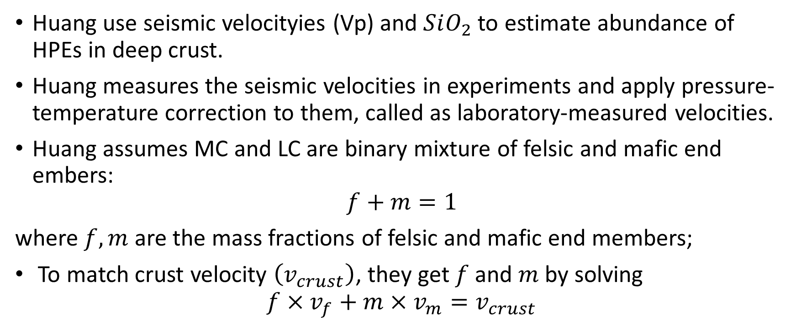
Huang use seismic velocityies (Vp) and $SiO_{2}$ to estimate abundance of HPEs in deep crust.
Huang measures the seismic velocities in experiments and apply pressure-temperature correction to them, called as laboratory-measured velocities.
Huang assumes MC and LC are binary mixture of felsic and mafic end embers:
$$f+m=1$$
where $f, m$ are the mass fractions of felsic and mafic end members;
To match crust velocity $\left(v_{crust}\right)$, they get $f$ and $m$ by solving
$$f×v_{f}+m×v_{m}=v_{crust}$$

Slide 4
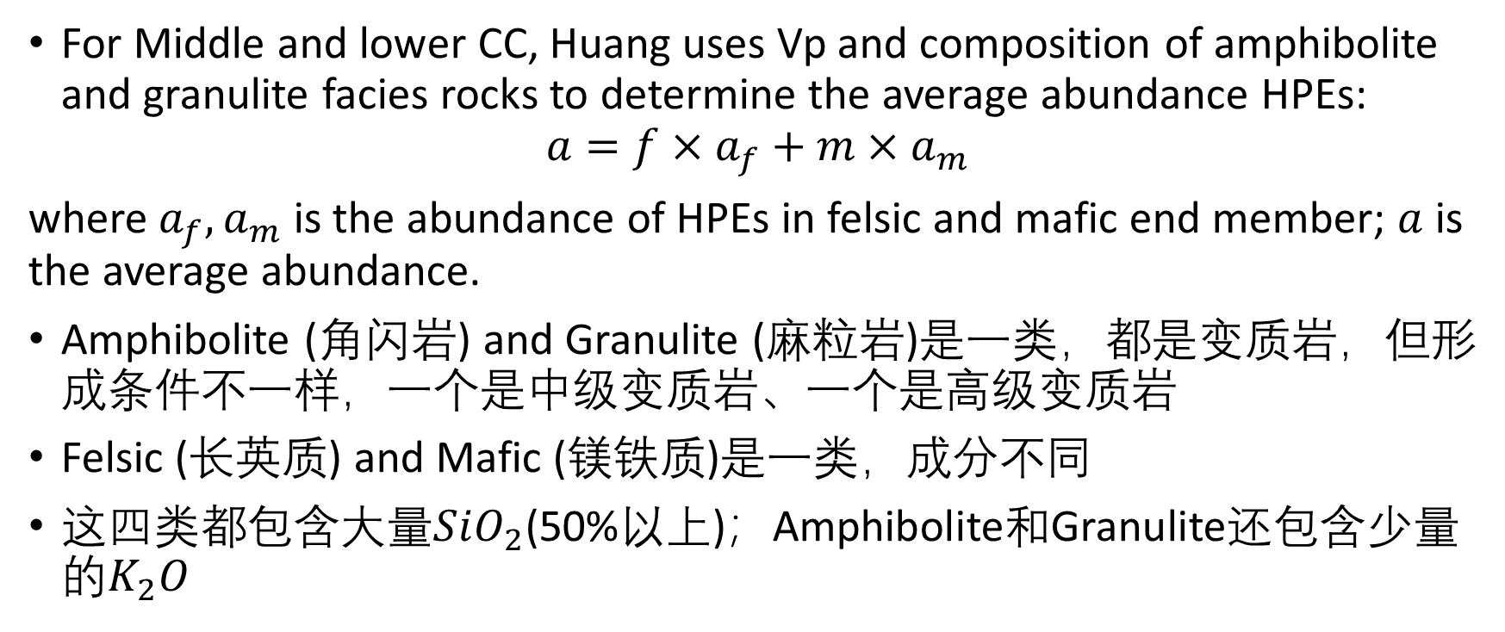
5. Methods of Analysis and Propagation of Uncertainties
For Middle and lower CC, Huang uses Vp and composition of amphibolite and granulite facies rocks to determine the average abundance HPEs:
$$a=f×a_{f}+m×a_{m}$$
where $a_{f}, a_{m}$ is the abundance of HPEs in felsic and mafic end member; $a$ is the average abundance.
Amphibolite (角闪岩) and Granulite (麻粒岩)是一类，都是变质岩，但形成条件不一样，一个是中级变质岩、一个是高级变质岩
Felsic (长英质) and Mafic (镁铁质)是一类，成分不同
这四类都包含大量$SiO_{2}$(50%以上)；Amphibolite和Granulite还包含少量的$K_{2}O$

Slide 5
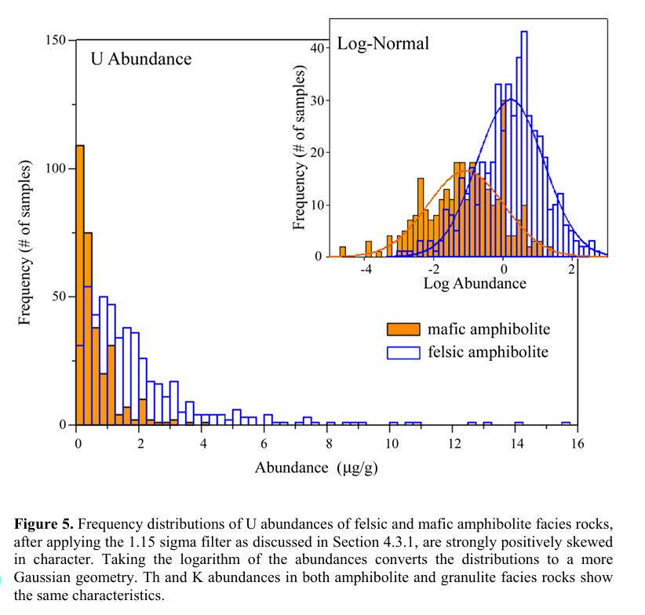
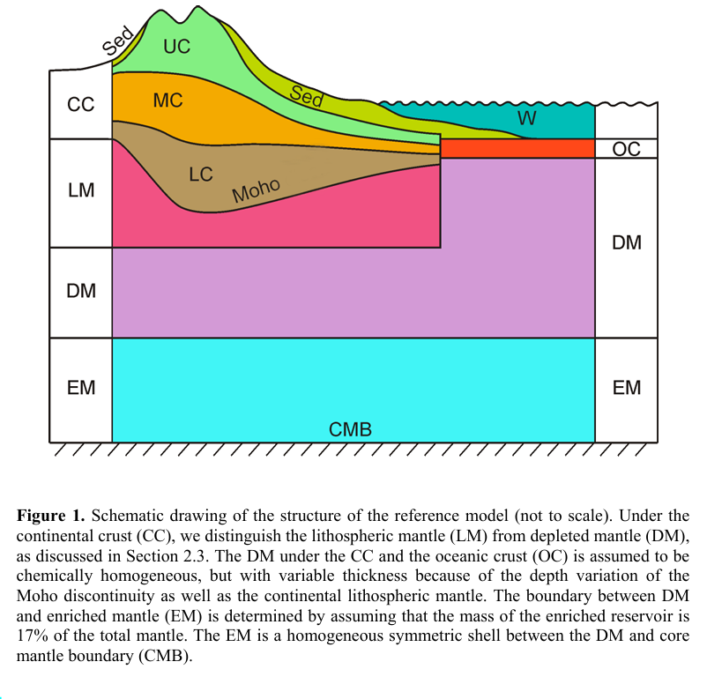
Felsic和mafic amphibolite的U丰度分布更倾向于log-normal分布

Slide 6
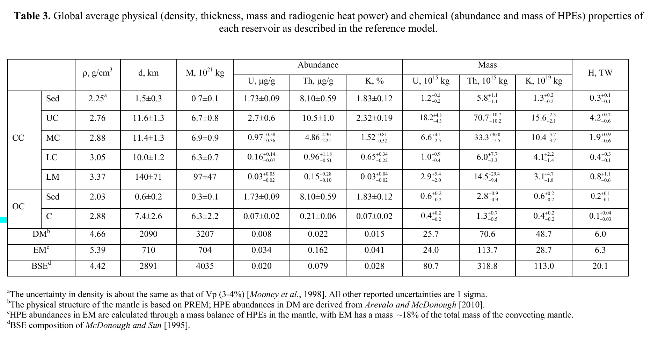

Slide 7
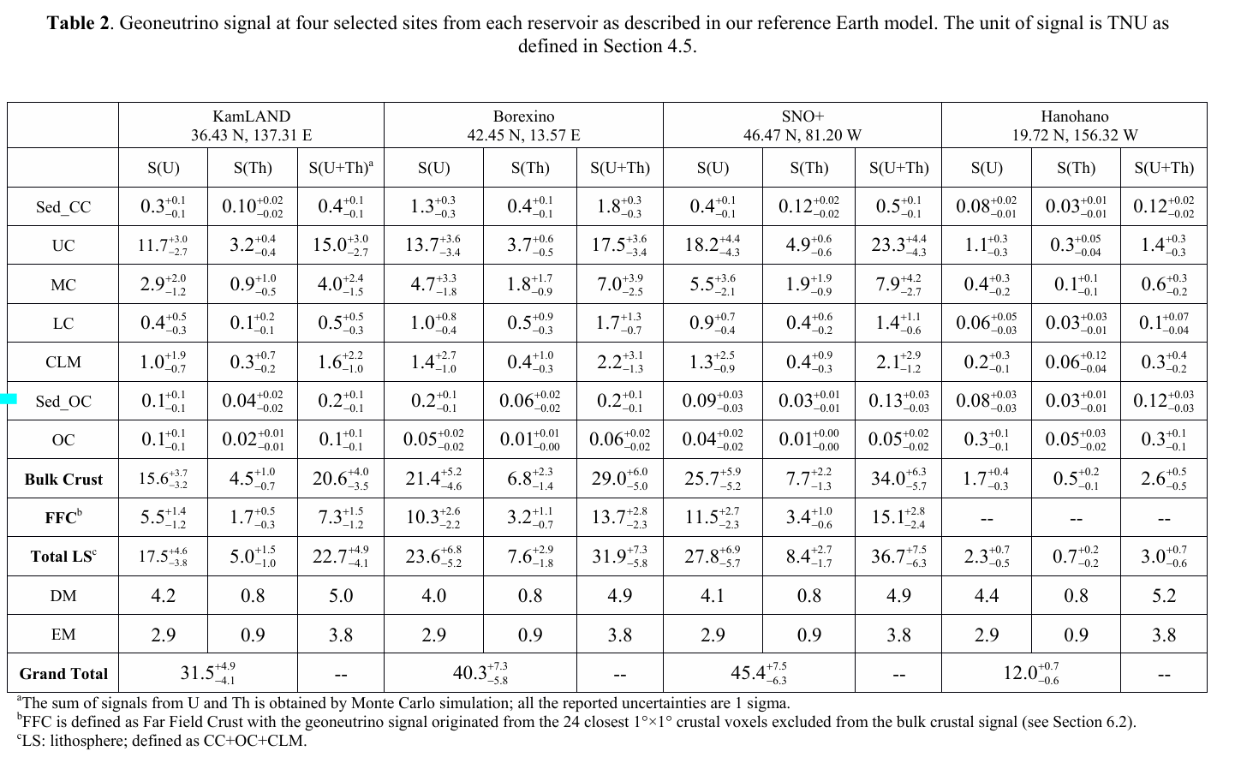

Slide 8
